Slide 1

What is Java & Why Should You Learn It?
Heather VanCura
Notes:
Java for new or junior or younger developers
What is Java and why should you learn it?
Target Audiences:
With Programming background:
High School students, college students, new developers
With no CS background: Abstract: Did you know that Java powers the most popular websites in the world? Java is the driving force behind Wikipedia, Spotify, Google, Amazon, and many other sites. Java was created over 25 years ago, and it continues to be one of the leading programming languages. Java developers are among the world’s most highly paid developers. In this talk, we will explain what Java is, how Java solves problems in the software industry, and how Java can guide your career growth. We will also provide resources to help you learn Java and explore how you can become a certified Java developer. We will show you how to stay informed when new versions of Java are released.. We’ll tell you how joining your local Java User Group builds your network and may eventually lead to an internship or a job. Come for Java; stay for all the fun! Ways to get involved :
Join your local JUG
Grow your network through JUGs to get internships
Contribute to Open Source and learn how to work on real life projects

Slide 2
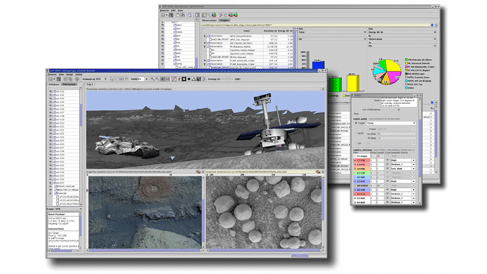
Where is Java used?
Notes:
In 2004, Java became the first programming language to expand humanity’s planetary reach. For three months that year, NASA scientists at the Jet Propulsion Laboratory (JPL) in Pasadena, California, used the Java-based Maestro Science Activity Planner built by JPL’s robot interface lab to control the Spirit Mars Exploration Rover as it explored the red planet.

Slide 3

Where is Java used?
Notes:
It’s fitting that an encyclopedia for the people, by the people should run on open source software—and feature a search engine powered by Java.
Check with attendees on how are they using wikipedia and then encourage them to think how Java is powering the search capabilities.

Slide 4

Where is Java used?
Notes:
Minecraft was launched in 2009 and released in 2011.
Over the years, it has amassed 250 million registered users and earned its developer, Mojang, a $2.5 billion payday from tech giant Microsoft in 2014.
126 million monthly users, 200 million copies sold
Use this slide to interact with the attendees and learn about their favorite Minecraft feature and think about how it might have been created.

Slide 5
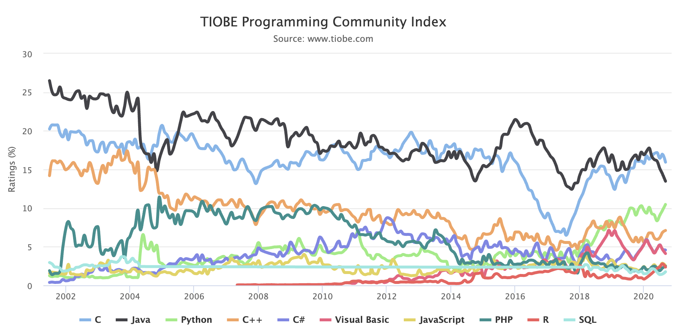
Popularity of programming languages
Notes:
The TIOBE Programming Community index is an indicator of the popularity of programming languages. The index is updated once a month. The ratings are based on the number of skilled engineers world-wide, courses and third party vendors. Popular search engines such as Google, Bing, Yahoo!, Wikipedia, Amazon, YouTube and Baidu are used to calculate the ratings. It is important to note that the TIOBE index is not about the best programming language or the language in which most lines of code have been written.
The index can be used to check whether your programming skills are still up to date or to make a strategic decision about what programming language should be adopted when starting to build a new software system.

Slide 6
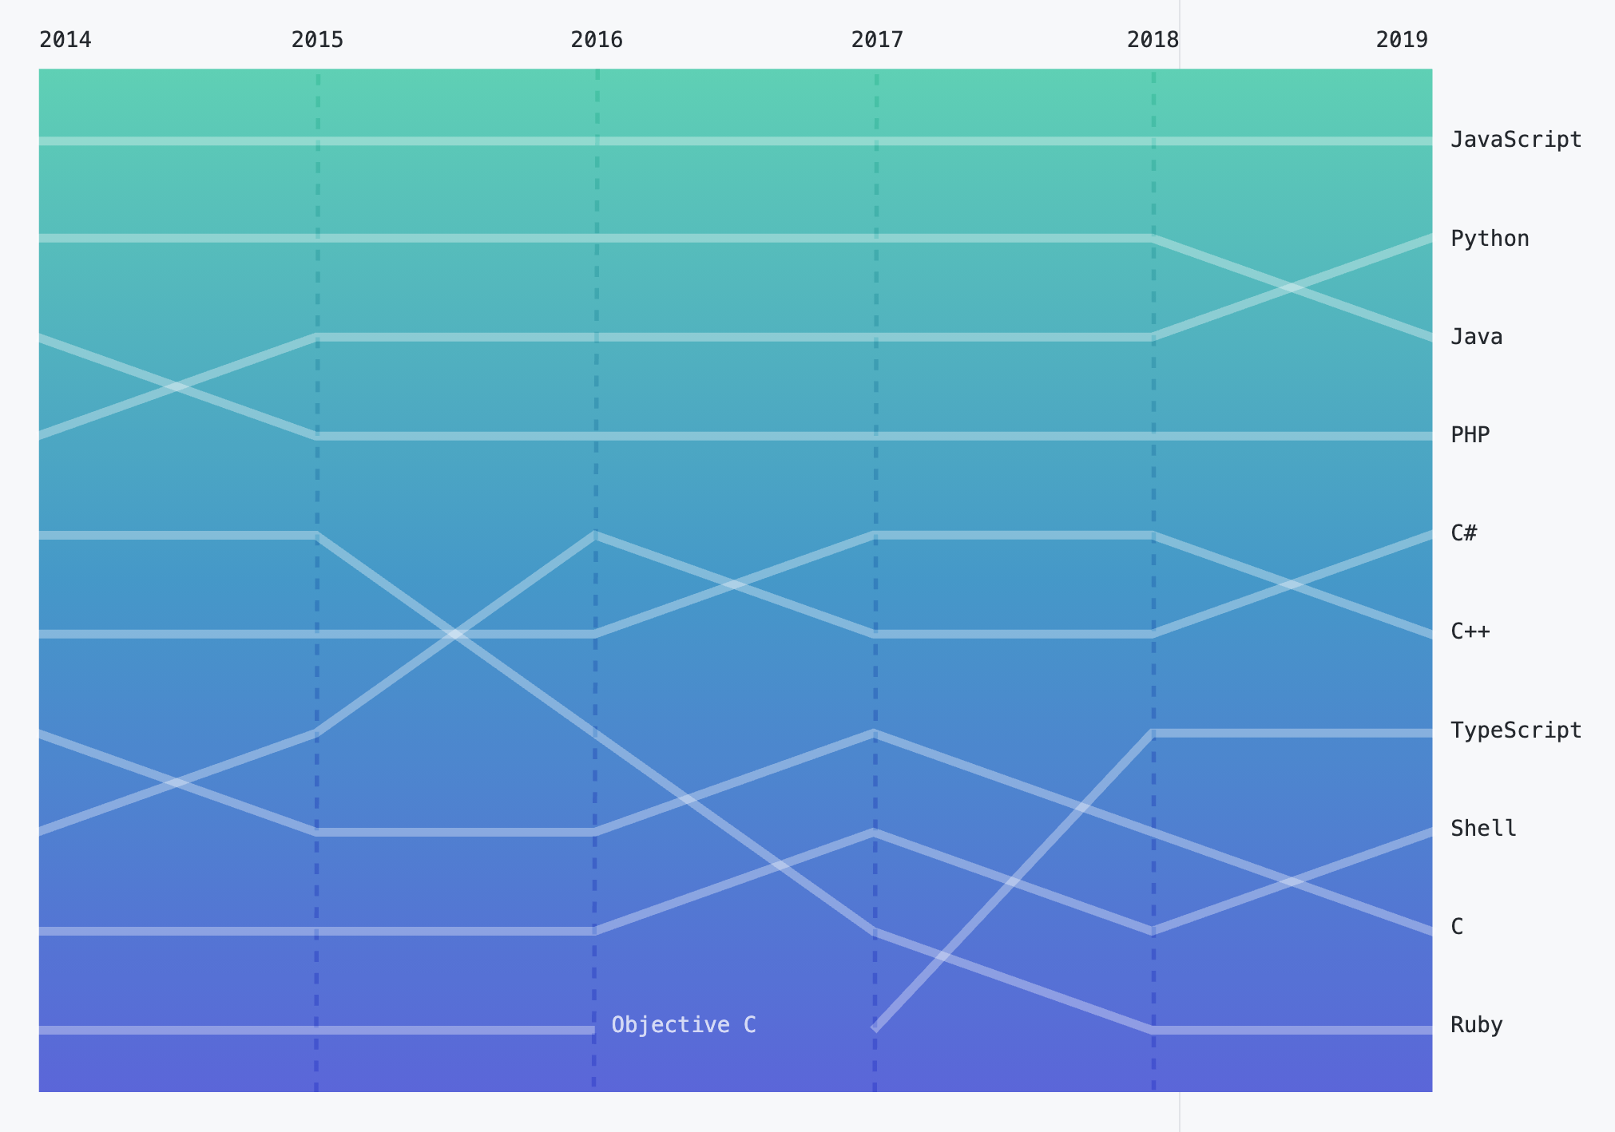
Language usage around the world
Notes:
This graph is from GitHub Survey Results 2020. GitHub is where majority of the developers around the world collaborate to write source code.
10M new developers joined the GitHub community, contributing to 44M+ repositories across every continent on earth. Behind the world’s code is a global and growing team of contributors, and 80% of them are contributing from outside the US.
In the last year, developers collaborated in more than 370 primary languages on GitHub.

Slide 7
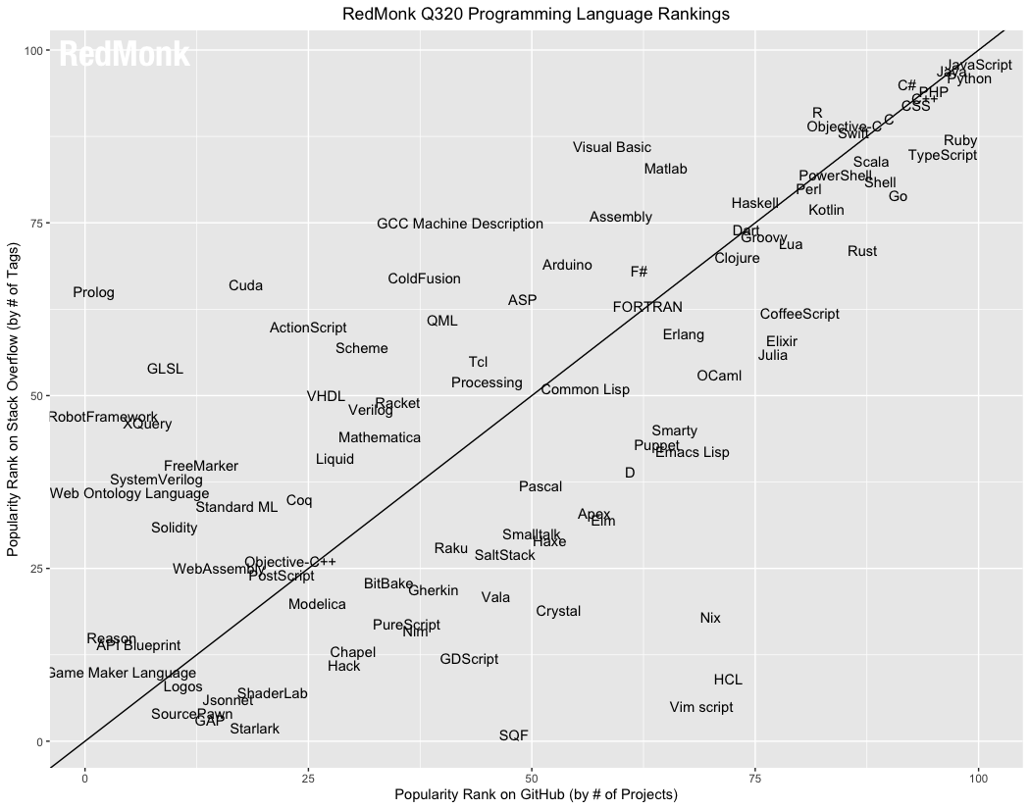
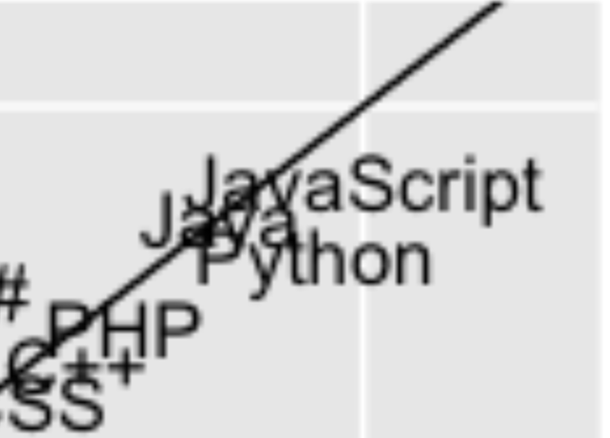
Insight into potential future trends
Notes:
This graph is programming language rankings by RedMonk, a popular industry analyst. https://redmonk.com/sogrady/2020/07/27/language-rankings-6-20/.
We extract language rankings from GitHub and Stack Overflow, and combine them for a ranking that attempts to reflect both code (GitHub) and discussion (Stack Overflow) traction. The idea is not to offer a statistically valid representation of current usage, but rather to correlate language discussion and usage in an effort to extract insights into potential future adoption trends.

Slide 8
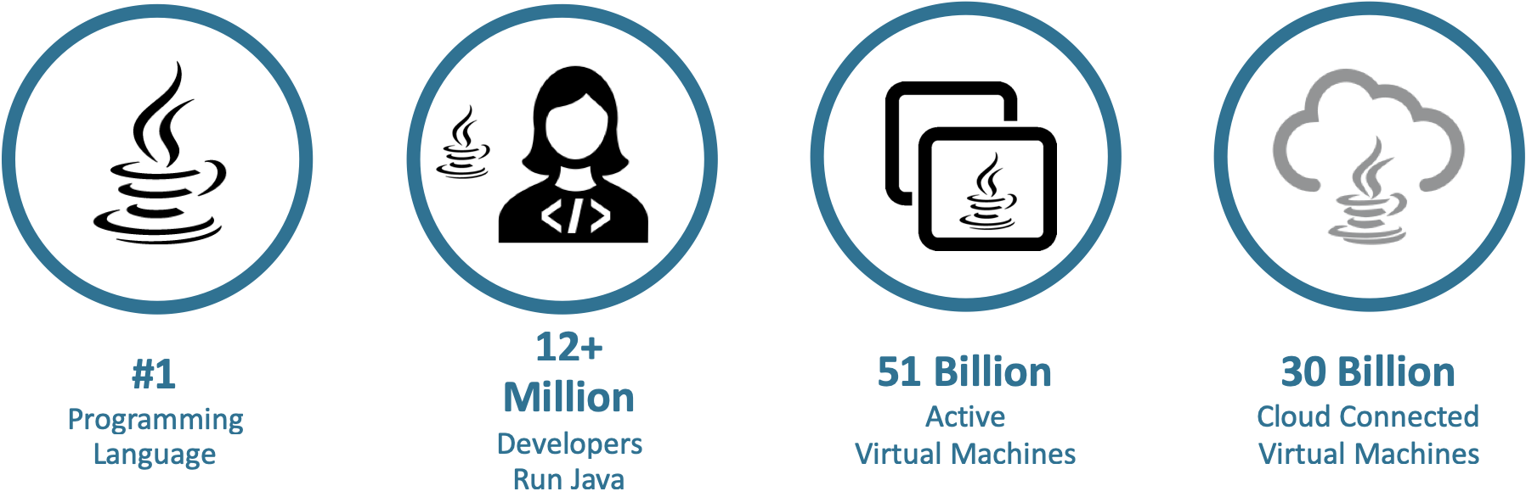
Java everywhere!
Notes:
In its 50 Best Jobs in America for 2021 report, Glassdoor gives Java Developer the number one ranking, beating jobs like Data Scientist, Product Manager, and Business Development Manager in overall job satisfaction. By giving this presentation to your JUG and to educators, you set the record straight. Java should be the first language taught to students. A career in software development should begin with Java

Slide 9











Which company uses Java?
Notes:
You want to work at any of these companies?
Java is the top in demand skill from employers for technical talent and also the most highly paid technical skill
Once you are working on projects in industry, it is difficult to find a project that does not include or touch some Java code.
TODO: Add more companies that would appeal to kids.

Slide 10

How to get started with Java?
academy.oracle.com
Notes:
Oracle Academy provides a wide range of FREE teaching resources, including curriculum, classroom learning resources, software, cloud technology, practice environments – for accredited, degree granting educational institutions.
Oracle Academy focus is on educational institutions and educators at those institutions.
We do not focus directly on students - we work directly with educators who then work with their students.
IT Professionals CANNOT become a member of Oracle Academy.
TODO: Add a note about searching for local institutions and connect with them.
Oracle Academy is “from the source”.

Slide 11

Engaging learners
Oracle Academy offers educational institutions and faculty the computing and technology teaching resources they need to engage, inspire, and prepare students with industry relevant skills to become technology innovators and leaders of the future.
Free program for educational institutions, educators, and their students
Helps students become career ready
Oracle’s philanthropic educational program
Notes:
Oracle Academy, Oracle’s global philanthropic educational program, is open to educators around the world to advance technology education, skills, innovation, and diversity and inclusion.
The program offers academic institutions and their educators free teaching and learning resources―including curriculum, cloud, software, and professional development―that help them prepare students with knowledge, hands-on practice, and career-relevant skills.

Slide 12
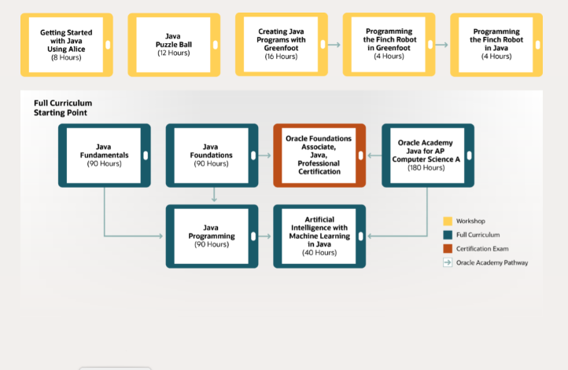
Free teaching and learning resources
Java pathway
Notes:
https://academy.oracle.com/en/solutions-curriculum-java.html

Slide 13


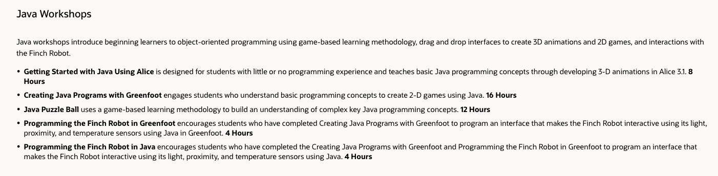






Workshop in a box
https://academy.oracle.com/en/training-workshops.html
Notes:
Oracle Academy membership/participation is for educational institutions and educators at those institutions.
We do not focus directly on students - we work directly with educators who then work with their students.
IT Professionals CANNOT become a member of Oracle Academy and cannot utilize these resources for personal or professional gain.
The curriculum pathway highlighted on this slide is for educators to use in the classroom to teach students.
We do provide resources called “Workshop in a Box (yellow squares above)”. These are “virtual” boxes that are designed for volunteers, educators, parents to utilize with students in order to help first experiences with computing fun and engaging. These workshop in a box resources do not include training. The public site to access these resources:
https://academy.oracle.com/en/training-workshops.html
Its not the robust curriculum as available to academic institution. It is always up to date, available in a variety of languages (7-8 languages).

Slide 14
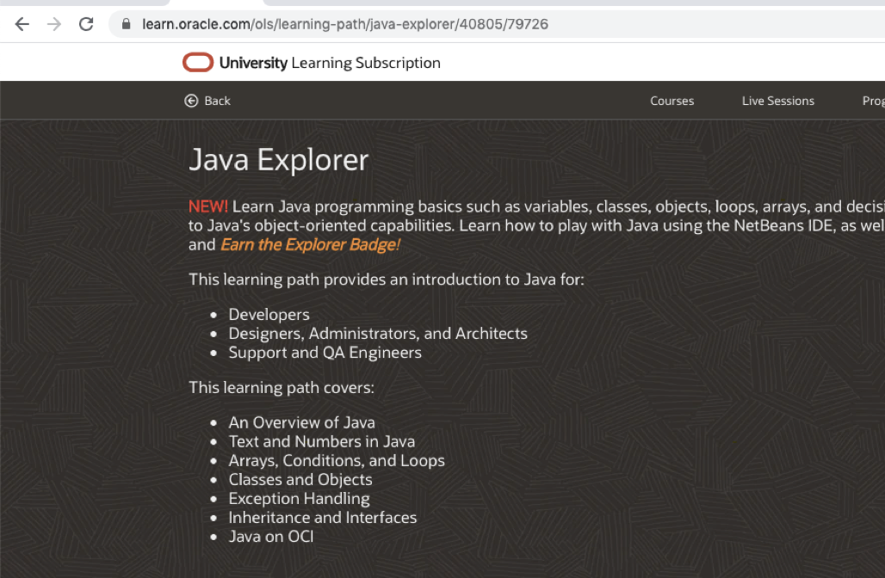
Java Explorer from Oracle University - free training
learn.oracle.com/ols/learning-path/java-explorer/40805/79726
Notes:
On your own as a student or professional learner through Oracle University.
Java Explorer course provides 6+ hours of free training.

Slide 15
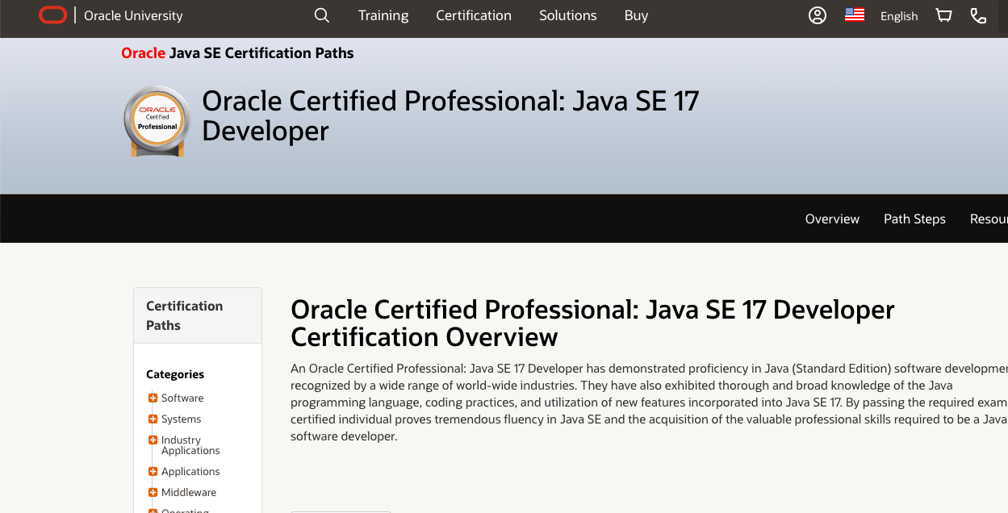
Java Training & Certifications
education.oracle.com
Notes:
https://education.oracle.com/oracle-certified-professional-java-se-17-developer/trackp_OCPJSE17
Java SE training and certification also available; Java SE 21 coming soon.
Also OU community for questions and discussion on OU content:
https://community.oracle.com/ou/

Slide 16
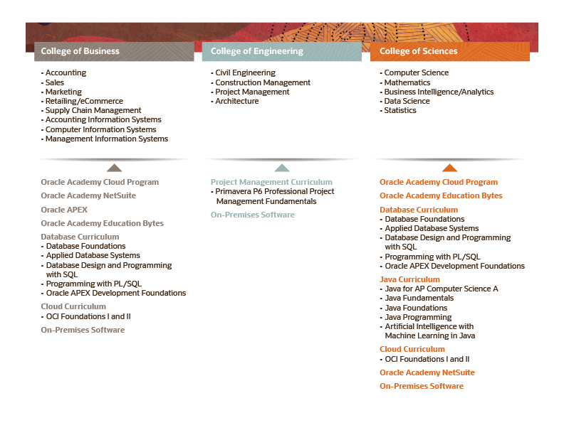
Notes:
This slide depicts where we commonly find our resources utilized in colleges and universities.

Slide 17
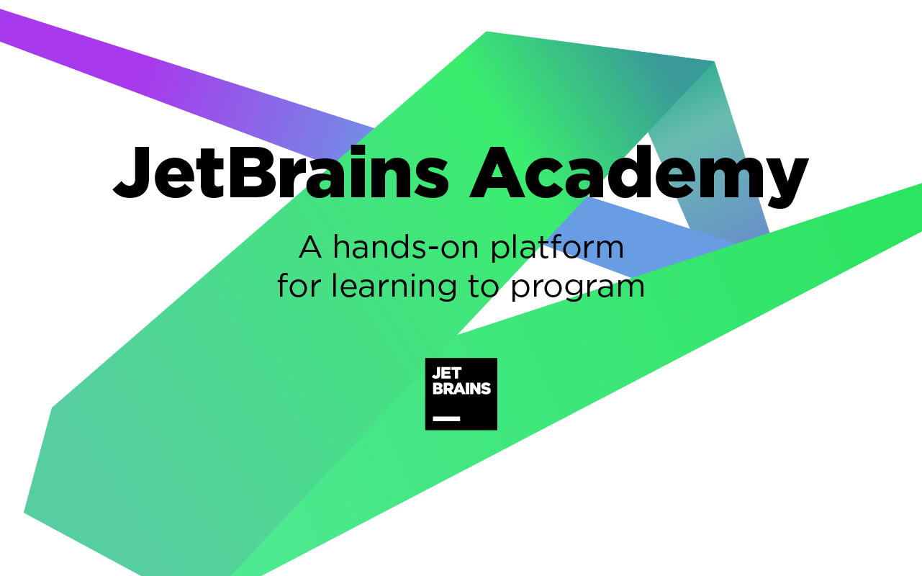
Learn Java by building working applications
Project-based learning: learn Java by building working applications.
Knowledge Map with single-concept Java topics and connections between them.
Your own personal study plan.
Text-based tutorials and interactive challenges.
Integration with professional JetBrains IDEs.
A community of over 270k learners.
After completing projects, publish them to GitHub to build your developer portfolio.
Extended 3-month free trial on JetBrains Academy: jb.gg/academy/java_in_education
Notes:
JetBrains recently launched JetBrains Academy, an education platform that offers interactive, project-based learning combined with powerful, professional development tools. Learn Java by creating working applications step by step in an interactive environment integrated with JetBrains IDEs. Follow the link to get an extended 3-month free trial on JetBrains Academy.

Slide 18
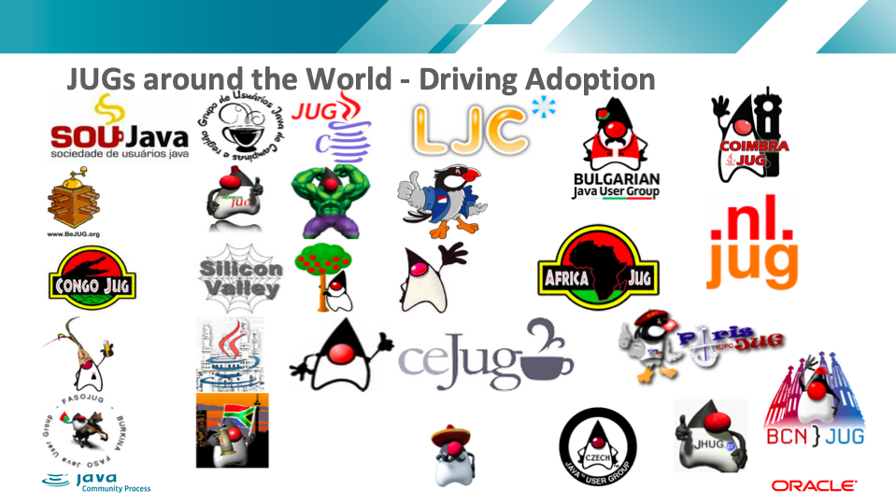
Notes:
https://jcp.org/en/participation/JUG_list - nearly 100 JUGs participating
JUGs can join the JCP program as Partner Members:
https://jcp.org/en/participation/jug

Slide 19
Next steps
Educators/Community Leaders
Students
Sign up as an Institutional Member of Oracle Academy to access Java resources including workshop in a box resources or full curriculum to utilize in the classroom to teach students.
If you work at an educational institution? Check to see if your institution is already a member.
JUG Leaders: Learn more by visiting the Oracle Academy website or contacting the Oracle Academy team; sign up as an Individual to teach a Workshop in a Box.
Take free Oracle University Java Explorer course.
Contact your local Java User Group (JUG).
Attend meetup and introduce yourself.
Ask for suggestions and recommendations for the JUG on the discussion list.
Offer to provide feedback and suggestions on your experience with (learning) Java.

Slide 20
Resources
Bring Java to next generation of developers:
https://jcp.org/java-in-education (join the groups.io list here)
–How Java is used in Industry (hear from JCP Members)
–How to host a discussion with your community members about getting involved with the initiative
https://github.com/jcp-org/Java-in-Education/wiki/Java-in-Education---Wiki-Page
Notes:
Recording of this presentation https://jcp.org/aboutJava/communityprocess/media/Java_in_Education_for_JUG_Leaders_November_2020.mp4

